Slide 1

Soccer Betting Analysis
By: Team 2 - Daniel Ozorio Delfin, Ryuichi Matsushita, Atharva Borole

Slide 2
Agenda
Introduction
Relavance
Data and H/W Specifications
Github & Code
Deliverables
Comparison

Slide 3

Introduction
In this presentation, we explore how soccer sports betting data can be used to predict the outcome of matches. By analyzing odds, betting patterns, and historical performance, we aim to uncover insights that enhance predictive accuracy.

Slide 4

Relevance
To develop a data-driven model that utilizes sports betting data to accurately predict soccer match outcomes, showcasing the potential of analytics in enhancing forecasting and decision-making in sports.
For the betting industry, more accurate models can help detect anomalies and reduce fraud. For sports analysts and teams, such models can uncover hidden performance trends and inform strategic decisions.

Slide 5
Data Specifications
Data Information:
Dataset URL:
Dataset Name | Dataset Size
*insert the name* | *insert the size*
*add link here*

Slide 6
H/W Specifications
Databricks on AWS
Databricks Runtime: 11.3 LTS ML (Scala 2.12, Spark 3.3.0)
CPU Speed: 2.3 GHz (i3.xlarge)
# of CPU cores: 4 per node x 2 = 8 cores total
# of nodes: 2 (1 driver, 1 worker)
Total Memory Size: 61 GiB (30.5 GiB per node x 2)

Slide 7
Github

Slide 8
Code

Slide 9
Spark vs Zeppelin Comparison...

Slide 10
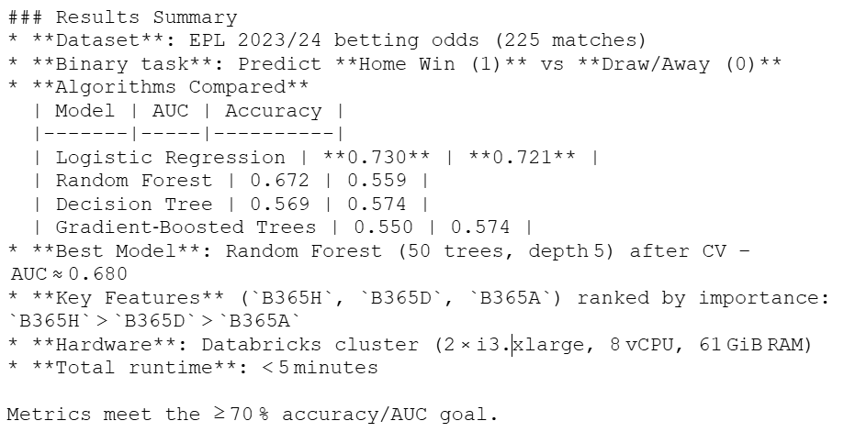
Zeppelin Results Summary

Slide 11
Columns that affect the accuracy the most are:

Slide 12
Conclusion
From our project,

Slide 13

Any questions?

Slide 14
Thank you!

